Slide 1
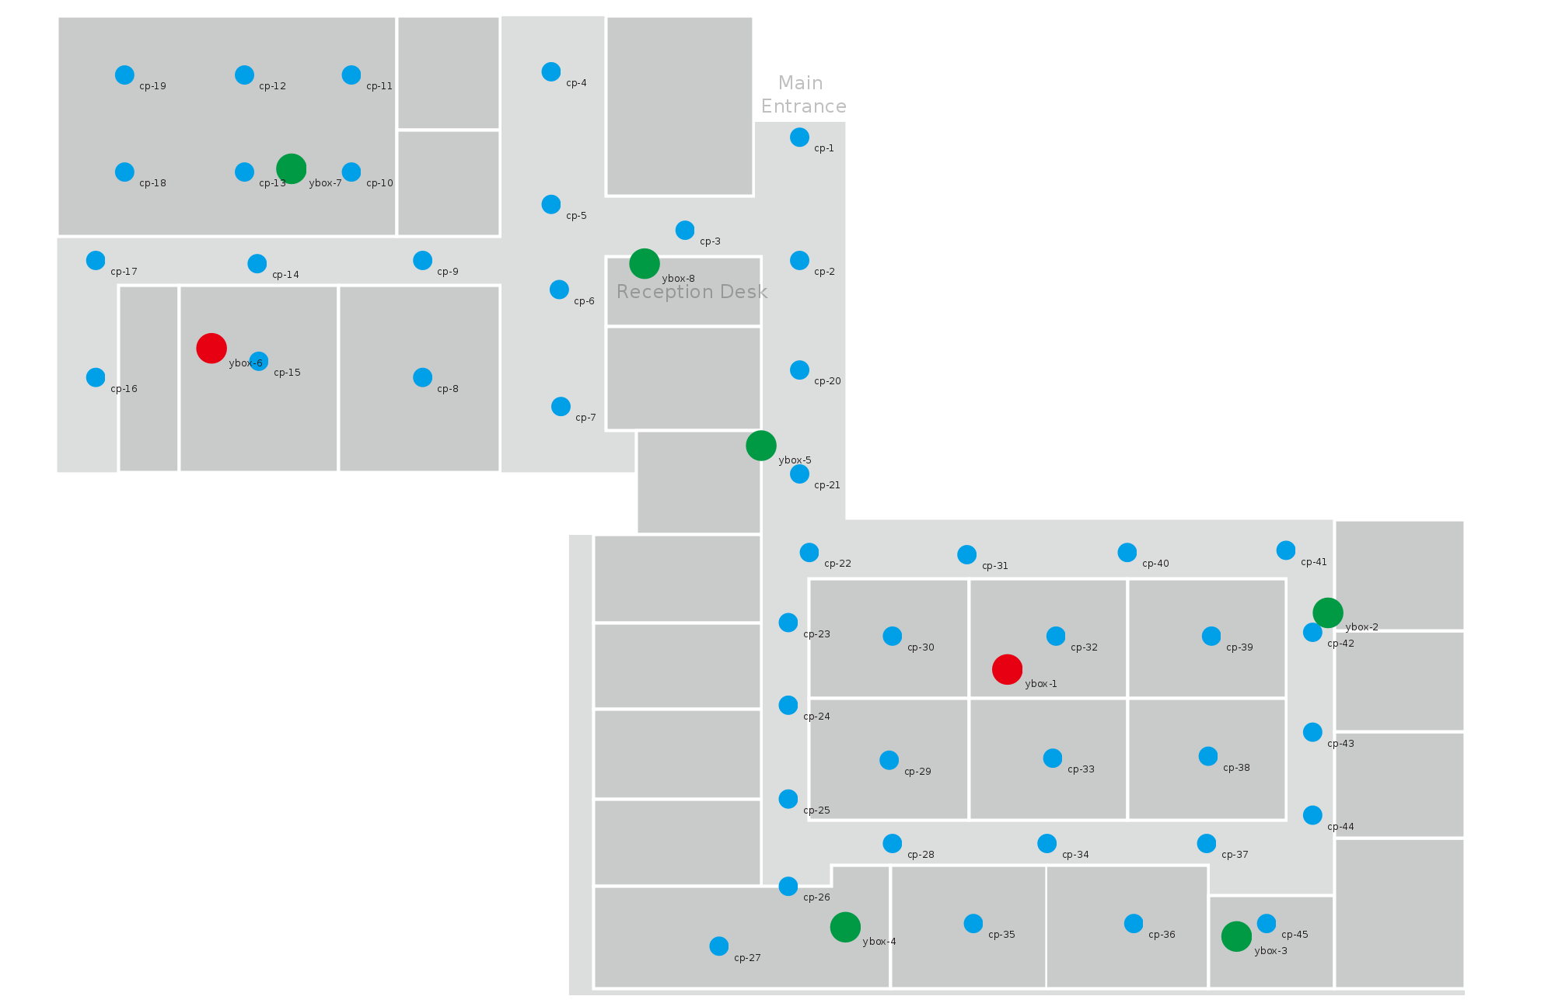
WiFi based localization system
This system has already been deployed in SinBerBEST Office.
45 reference points during offline stage (blue points)
8 WiFi routers (red and green points)
CREATE tower level 11, SinBerBEST Laboratory and Office Space

Slide 2
WiFi based localization accuracy test result
Unit m | Real |  | Iphone |  |  | Android
No. | X | Y | Average X | Average Y | Accuracy | Average X | Average Y | Accuracy
1 | 17 | 2.2 | 19.7882 | 7.261697 | 5.778826 | 7.125 | 9.95 | 12.55301
2 | 13.1 | 11.7 | 15.68232 | 12.25335 | 2.640945 | 14.725 | 9.5 | 2.735073
3 | 10.9 | 2.3 | 6.906129 | 2.642671 | 4.008545 | 7.5 | 8.56 | 7.123735
4 | 8 | 11.2 | 7.509336 | 6.025104 | 5.198105 | 19.9 | 14.05 | 12.23652
5 | 3 | 8.1 | 7.999745 | 7.001596 | 5.118979 | 12.63333 | 6.2 | 9.818916
6 | 24.7 | 11.4 | 24.70997 | 11.20034 | 0.199906 | 23.5 | 13.8 | 2.683282
7 | 25 | 17.1 | 28.68231 | 18.29862 | 3.87248 | 28.52 | 16.2 | 3.633235
8 | 24.3 | 24.7 | 23.10943 | 27.93762 | 3.449584 | 35.82 | 23.94 | 11.54504
9 | 22.2 | 29.3 | 26.11299 | 27.50842 | 4.303633 | 30.9 | 21.26 | 11.84616
10 | 27.5 | 23.5 | 25.01037 | 21.60455 | 3.129054 | 37.9 | 23.3 | 10.40192
11 | 27.6 | 19.7 | 28.26831 | 19.44187 | 0.716426 | 27.58 | 22.52 | 2.820071
12 | 32.6 | 19.7 | 30.6684 | 18.36772 | 2.346497 | 34 | 16.86 | 3.166323
13 | 32.5 | 23.4 | 37.06094 | 18.93676 | 6.381431 | 39.88 | 22.94 | 7.394322
14 | 30.1 | 28.6 | 26.91627 | 25.7357 | 4.282559 | 38.02 | 20.86 | 11.07402
15 | 35 | 28.6 | 37.04425 | 25.98699 | 3.317641 | 40.44 | 20.92 | 9.411482
16 | 37.3 | 23.4 | 38.86633 | 22.93834 | 1.632948 | 34.06 | 21.58 | 3.716181
17 | 37.4 | 19.7 | 38.42077 | 20.28423 | 1.176137 | 40.44 | 20.92 | 3.275668
18 | 39.7 | 17 | 38.50086 | 19.29034 | 2.585269 | 41 | 18.9 | 2.302173
19 | 40.5 | 25.2 | 38.80785 | 24.7681 | 1.746401 | 39.88 | 22.94 | 2.343502
20 | 39.1 | 28.6 | 38.08303 | 25.69046 | 3.082147 | 38.02 | 20.86 | 7.814986
Average accuracy |  |  |  |  | 3.248376 |  |  | 6.894782
20 test points are randomly selected.
At each test point, around 10 RSSI vector samples are recorded in 3 minutes.

Slide 3
WiFi based localization accuracy test result
The average accuracy for iPhone is 3.25m. The average accuracy for Android is 6.89m. iPhone is more accurate because they used the same iPhone to do the calibration during the offline stage.
For further accuracy test , we will perform with another model of iPhone and Android phone.

Slide 4
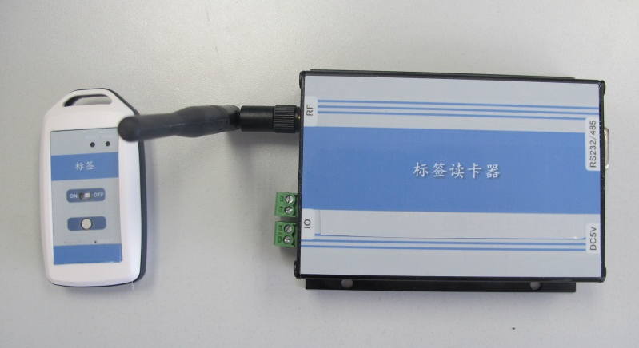
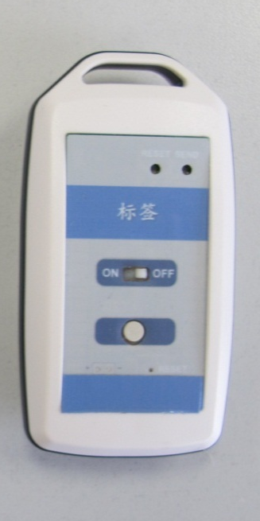
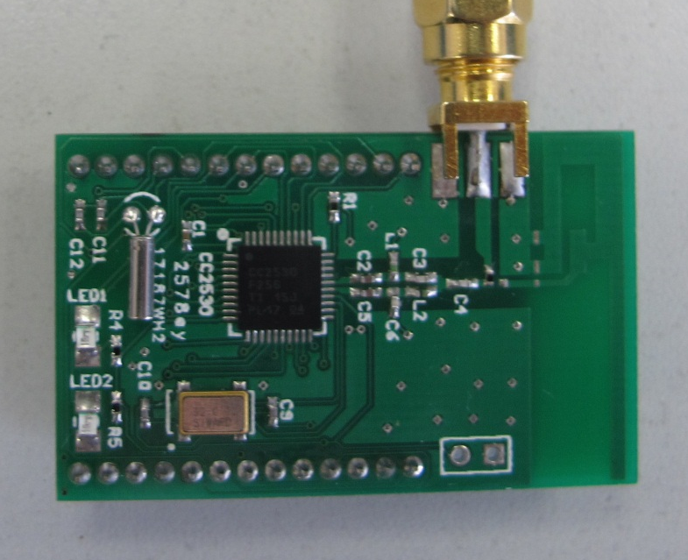
Active RFID localization system
System Property
Use active RFID tags
ZigBee 2.4GHz communication Protocol
Maximum communication distance: 80 m
Localization accuracy: 1-3 m
Active RFID tag
Price of each tag: ￥100
Tag size: 6cm×3.5cm
Tag thickness: 1.2cm
Communication module: TICC2530
Battery life: around one month

Slide 5
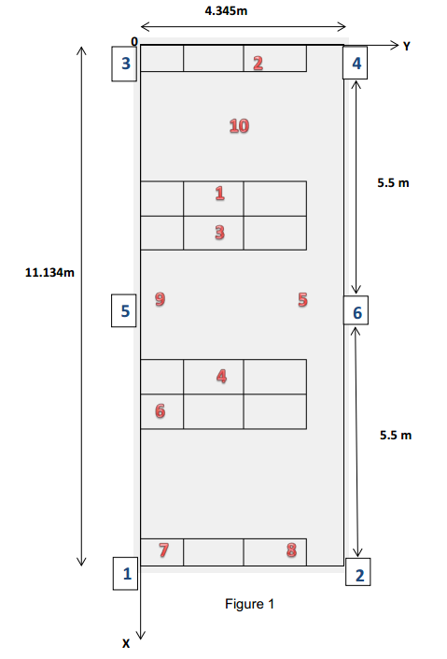
RFID localization accuracy test
Test environment: Tsinghua CFNIS office room
(Area: 11.134m × 4.345m)
6 RFID readers are distributed in the office.
10 test points are randomly selected. (Their positions are shown in Figure 1)
We use RSSI-based localization algorithm in this test. The sampling rate is 1s. An occupant takes an active RFID tag and walks around in the office. At each test point, around 150 RSSI vector samples are recorded in 3 minutes.

Slide 6

RFID localization accuracy test result
Table 1
Unit: m | Real X | Real Y | Average X | Average Y | Variance X | Variance Y | Accuracy X | Accuracy Y
1 | 2.930 | 2.085 | 3.140 | 1.145 | 0.081 | 0.028 | 0.210 | 0.939
2 | 0.293 | 2.680 | 0.403 | 1.299 | 0.014 | 0.04 | 0.110 | 1.381
3 | 4.395 | 1.508 | 4.365 | 1.429 | 0.063 | 0.054 | 0.030 | 0.079
4 | 6.739 | 1.508 | 6.230 | 1.013 | 0.022 | 0.013 | 0.419 | 0.495
5 | 5.860 | 3.266 | 5.958 | 2.343 | 0.092 | 0.147 | 0.098 | 0.923
6 | 8.204 | 0.336 | 8.898 | 1.562 | 0.045 | 0.075 | 0.784 | 1.226
7 | 10.548 | 0.336 | 10.923 | 0.441 | 0.005 | 0.044 | 0.375 | 0.105
8 | 10.548 | 2.680 | 10.125 | 1.940 | 0.007 | 0.042 | 0.423 | 0.740
9 | 5.860 | 1.508 | 5.663 | 1.125 | 0.015 | 0.024 | 0.197 | 0.024
10 | 1.758 | 2.094 | 1.284 | 1.317 | 0.043 | 0.027 | 0.473 | 0.777
Average |  |  |  |  | 0.039 | 0.049 | 0.312 | 0.669
Real value is the physical location of the test point.
$$Accuracy=\left|Real value−Average value of samples\right|$$

Slide 7
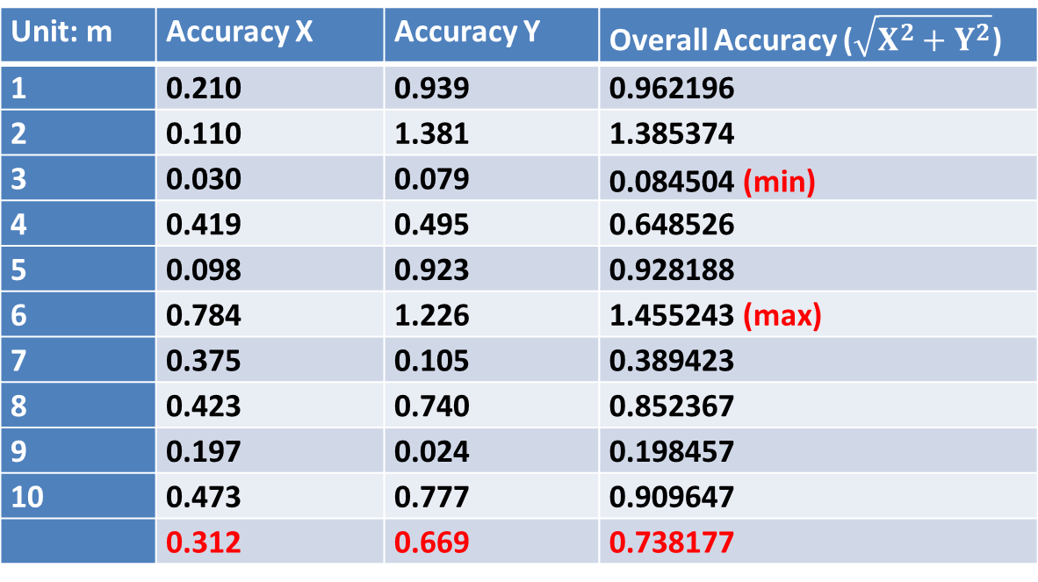
RFID localization accuracy test result
Table 2
Unit: m | Accuracy X | Accuracy Y | Overall Accuracy ($\sqrt{X^{2}+Y^{2}}$)
1 | 0.210 | 0.939 | 0.962196
2 | 0.110 | 1.381 | 1.385374
3 | 0.030 | 0.079 | 0.084504 (min)
4 | 0.419 | 0.495 | 0.648526
5 | 0.098 | 0.923 | 0.928188
6 | 0.784 | 1.226 | 1.455243 (max)
7 | 0.375 | 0.105 | 0.389423
8 | 0.423 | 0.740 | 0.852367
9 | 0.197 | 0.024 | 0.198457
10 | 0.473 | 0.777 | 0.909647
 | 0.312 | 0.669 | 0.738177
The localization accuracy range of this active RFID system is from 0.085 to 1.455 m. The average positioning accuracy of 10 test points are (X: 0.312m, Y: 0.669m, overall: 0.738m).
In conclusion, the localization accuracy of this system is within 1.5m

Slide 8
Summary of RFID localization system
Can uniquely identify occupants
High localization accuracy
Relative low price active RFID system
Small size and lightweight tag
Can be integrated with access card in the future
Occupant needs to wear RFID tag (but these tags quite light and small)
The accuracy of an RFID system is directly related to the density of tag deployment and reading ranges

Slide 9
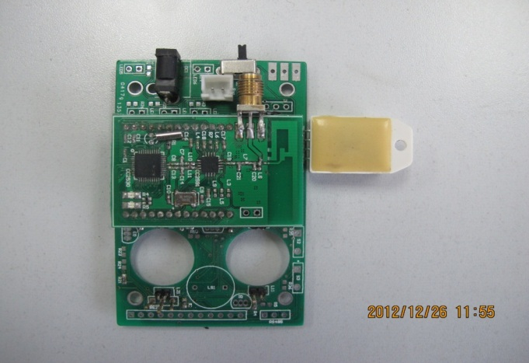
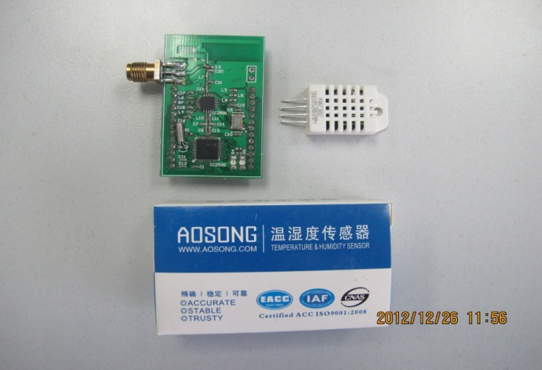
Integration with other environmental sensors
Active RFID reader with temperature and humidity sensors
Temperature and humidity sensors
Active RFID reader
RFID reader can be further integrated with temperature and humidity sensors

Slide 10


Deployment plan of RFID localization system in SinBerBEST
RFID readers: 60×S$20=S$1200
RFID tags: 50×S$20=S$1000
Backup tags and maintenance:S$1300
Total: <S$10000

